Slide 1
Which one of the following diagnoses is most likely in a 36-year-old man who presents with a 2-week history of a mononucleosis-type syndrome with oral ulceration, fever, night sweats, headache, and a light patchy exanthem on the chest; who traveled to South Africa 5 weeks ago; and who reports a new sexual partner? A) African tick-bite fever B) Influenza infection C) Dengue fever D) Plasmodium falciparum malaria E) Primary HIV infection
NEJM.org | July 9, 2015

Slide 2
Your answer is correct.
Primary HIV infection
Common symptoms associated with primary HIV infection include fever, myalgias, rash, pharyngitis, and oral and/or genital ulcers.
Symptoms of primary HIV infection can begin days after initial exposure and can last for several weeks, followed by a long asymptomatic period. Common symptoms include fever, arthralgias, myalgias, headache, rash, pharyngitis, and oral and/or genital ulcers. Patients may also describe malaise, lymphadenopathy, and weight loss. Diagnosis of primary HIV infection requires a high index of suspicion because the clinical presentation may mimic self-limited illness caused by other viruses or may be erroneously attributed to concurrent sexually transmitted infections. Traditional antibody testing can be negative or indeterminate in cases of primary HIV infection; the diagnosis is confirmed by obtaining an HIV RNA viral load.
Influenza infection is an acute, seasonal illness that usually causes chills, fever, runny nose, sore throat, myalgias, headache, cough, and weakness. It does not typically cause symptoms for longer than 2 weeks and is not associated with rash or oral ulcers.
Plasmodium falciparum malaria, African tick-bite fever, and dengue fever should be considered in individuals returning from travel to Africa with an unexplained febrile illness; however, these infections have relatively short incubation periods. In addition, malaria is not typically associated with maculopapular rash, oral ulcers, or lymphadenopathy. People with African tick-bite fever usually have an eschar at the site of inoculation. Dengue fever is not endemic in South Africa.
Cohen MS et al. Acute HIV-1 Infection. N Engl J Med 2011 May 20; 364:1943.
Daar ES et al. Clinical presentation and diagnosis of primary HIV-1 infection. Curr Opin HIV AIDS 2008 Jan 1; 3:10.
Wilson ME and Freedman DO. Etiology of travel-related fever. Curr Opin Infect Dis 2007 Sep 1; 20:449.

Slide 3
Lancet. 2001 Apr 14;357(9263):1149-53. Probability of HIV-1 transmission per coital act in monogamous, heterosexual, HIV-1-discordant couples in Rakai, Uganda. Gray RH, Wawer MJ, Brookmeyer R, Sewankambo NK, Serwadda D, Wabwire-Mangen F, Lutalo T, Li X, vanCott T, Quinn TC; Rakai Project Team. Abstract BACKGROUND: The probability of HIV-1 transmission per coital act in representative African populations is unknown. We aimed to calculate this probability overall, and to estimate how it is affected by various factors thought to influence infectivity.

Slide 4
Abstract METHODS: 174 monogamous couples, in which one partner was HIV-1 positive, were retrospectively identified from a population cohort in Rakai, Uganda. Frequency of intercourse and reliability of reporting within couples was assessed prospectively. HIV-1 seroconversion was determined in the uninfected partners, and HIV-1 viral load was measured in the infected partners. Adjusted rate ratios of transmission per coital act were estimated by Poisson regression. Probabilities of transmission per act were estimated by log-log binomial regression for quartiles of age and HIV-1 viral load, and for symptoms or diagnoses of sexually transmitted diseases (STDs) in the HIV-1-infected partners.

Slide 5
A) 1:10 B) 1:100 C) 1:1000 D) 1:10000
So what was the transmission rate?

Slide 6
Abstract RESULTS: The mean frequency of intercourse was 8.9 per month, which declined with age and HIV-1 viral load. Members of couples reported similar frequencies of intercourse. The overall unadjusted probability of HIV-1 transmission per coital act was 0.0011 (95% CI 0.0008-0.0015) (1:1000). Transmission probabilities increased from 0.0001 per act at viral loads of less than 1700 copies/mL to 0.0023 (2:1000) per act at 38 500 copies/mL or more (p=0.002), and were 0.0041 (4:1000) with genital ulceration versus 0.0011 without (p=0.02). Transmission probabilities per act did not differ significantly by HIV-1 subtypes A and D, sex, STDs, or symptoms of discharge or dysuria in the HIV-1-positive partner. INTERPRETATION: Higher viral load and genital ulceration are the main determinants of HIV-1 transmission per coital act in this Ugandan population.

Slide 7
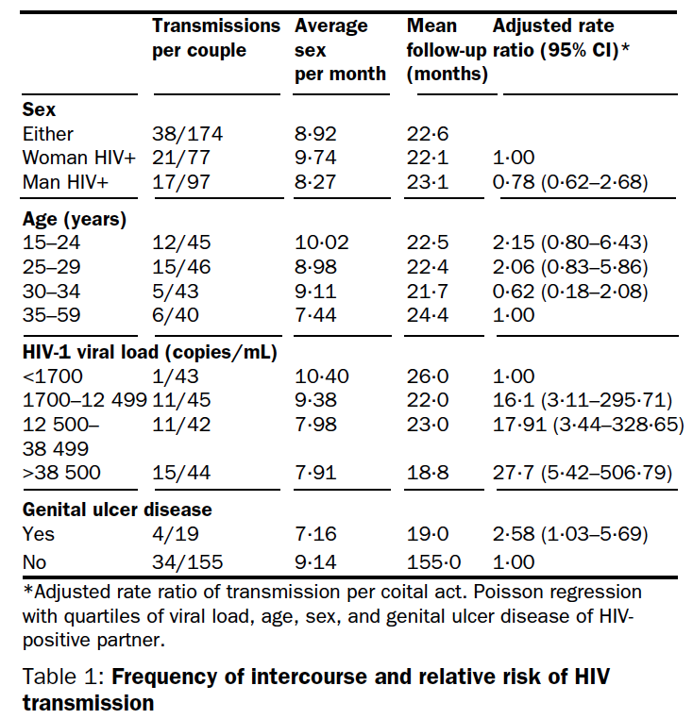

Slide 8
A) People have sex a lot B) This study is wrong C) HIV does not cause AIDS D) There is something that we are not understanding
Why do we have so many new infections if transmission is 1:1000?

Slide 9
Science 12 JUNE 2015 • VOL 348 ISSUE 6240
Christophe Fraser, an epidemiologist at Imperial College London, and his colleagues hope to bolster prevention efforts in the Netherlands with their analysis of more than 13,000 HIV sequences from a cohort of predominantly MSM. They identified 106 distinct transmission networks and 883 probable transmitters, 69.2% of whom had undiagnosed infections; diagnosed people on ARV treatment, in contrast, rarely transmitted. What’s more, 40% of the probable transmitters had just recently become infected, a time when they are most infectious. Models suggest that treating high-risk people who test negative for HIV with ARVs, a strategy called preexposure prophylaxis, could lead to “substantial reductions in transmission” in the Netherlands, Fraser said.

Slide 10
UCSD’s Davey Smith and co-workers created an HIV transmission network map, shown here in December 2014, from 15 years of sequence data.

Slide 11
Science 12 JUNE 2015 • VOL 348 ISSUE 6240
At the heart of the technique is the assumption that if the HIV sequences found in two people differ by less than 1.5%, then they are in a “transmission cluster.” This does not prove that one person infected the other—there could have been intermediaries— but their infections are closely linked. Because HIV mutates at a constant rate, researchers can also construct a molecular clock to estimate when the transmission took place. Combining the information from many HIV-infected people in a limited geographical area creates diagrams that resemble airline routing maps, allowing researchers to infer the direction and speed of spread.

Slide 12
Science 12 JUNE 2015 • VOL 348 ISSUE 6240
With researchers from the University of California, San Diego, Oster’s team mined HIV sequences from 27 sites around the country. They found that in men who report having sex with men (MSM), that explains the transmission 88% of the time. But surprisingly, Oster said, among men and women who inject drugs, the most common source of infection is not needle sharing but sex involving MSM. Also unexpected: Infections in heterosexual women were more frequently linked to MSM than to heterosexual men.

Slide 13
Infect Dis. 2005 May 1;191(9):1403-9.
Rates of HIV-1 transmission per coital act, by stage of HIV-1 infection, in Rakai, Uganda.
Wawer MJ, Gray RH, Sewankambo NK, Serwadda D, Li X, Laeyendecker O, Kiwanuka N, Kigozi G, Kiddugavu M, Lutalo T, Nalugoda F, Wabwire-Mangen F, Meehan MP, Quinn TC.
Abstract
BACKGROUND:
We estimated rates of human immunodeficiency virus (HIV)-1 transmission per coital act in HIV-discordant couples by stage of infection in the index partner.
METHODS:
We retrospectively identified 235 monogamous, HIV-discordant couples in a Ugandan population-based cohort. HIV transmission within pairs was confirmed by sequence analysis. Rates of transmission per coital act were estimated by the index partner's stage of infection (recent seroconversion or prevalent or late-stage infection). The adjusted rate ratio of transmission per coital act was estimated by multivariate Poisson regression.

Slide 14
Infect Dis. 2005 May 1;191(9):1403-9.
Rates of HIV-1 transmission per coital act, by stage of HIV-1 infection, in Rakai, Uganda.
Wawer MJ, Gray RH, Sewankambo NK, Serwadda D, Li X, Laeyendecker O, Kiwanuka N, Kigozi G, Kiddugavu M, Lutalo T, Nalugoda F, Wabwire-Mangen F, Meehan MP, Quinn TC.
Abstract
RESULTS:
The average rate of HIV transmission was 0.0082/coital (8/1000) act (95% confidence interval [CI], 0.0039-0.0150) within approximately 2.5 months after seroconversion of the index partner; 0.0015/coital act within 6-15 months after seroconversion of the index partner (95% CI, 0.0002-0.0055); 0.0007/coital act (95% CI, 0.0005-0.0010) among HIV-prevalent index partners; and 0.0028/coital act (95% CI, 0.0015-0.0041) 6-25 months before the death of the index partner. In adjusted models, early- and late-stage infection, higher HIV load, genital ulcer disease, and younger age of the index partner were significantly associated with higher rates of transmission.
CONCLUSIONS:
The rate of HIV transmission per coital act was highest during early-stage infection. This has implications for HIV prevention and for projecting the effects of antiretroviral treatment on HIV transmission.

